Slide 1

FINAL PROJECT – HOTEL BOOKINGS DATA ANALYTICS 1 (ADTA 5130)
Project Group Members:
(Group 25)
1) Vishwa Tej Reddy Chitla (11645954)
2) Lakshmi Prasanna Kommineni (11648973)
3) Zakiya AI Jabri (11727401)

Slide 2
Outline
Project Overview
Exploratory Data Analysis & Data Cleaning
One-Way ANOVA Model
Two-Way ANOVA Model
Linear Regression Model
Logistic Regression Model
Polynomial Regression Model
Conclusion

Slide 3
Project Overview
To extract actionable insights and recommendations for the hotels how they should operate from the hotel booking dataset.
Emphasis on the importance: Informing strategic decisions for revenue optimization, guest satisfaction, and operational efficiency.
Includes exploratory data analysis (EDA) to identify patterns and employs statistical models (ANOVA, regression) to address specific problem statements.
Uncovering hidden relationships within the data to provide informed guidance for hotels.

Slide 4
Exploratory Data Analysis & Data cleaning
Dataset used for this project is hotel_bookings. This Data set is comprised of a total of 32 different variables and 119391 observations of hotel booking data for the period 2015-2017.
Variables in the Data set comprise numeric data, categorical variables, and binary data.
Utilized Excel functions to derive summary statistics (mean, median, min, max) for numeric variables such as lead_time, stays_in_weekend_nights, stays_in_week_nights, adults, etc.
Identifying missing values across columns and for data completeness replacing missing values with mean of non-null values.

Slide 5
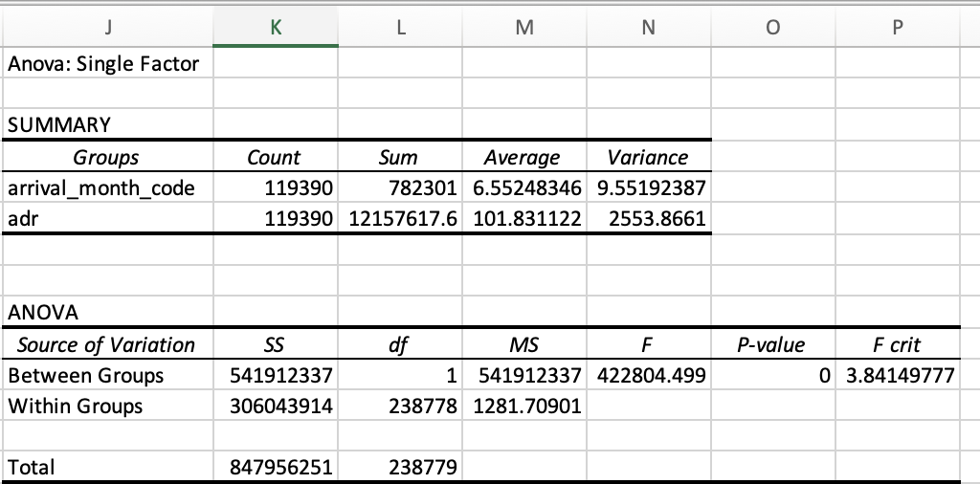
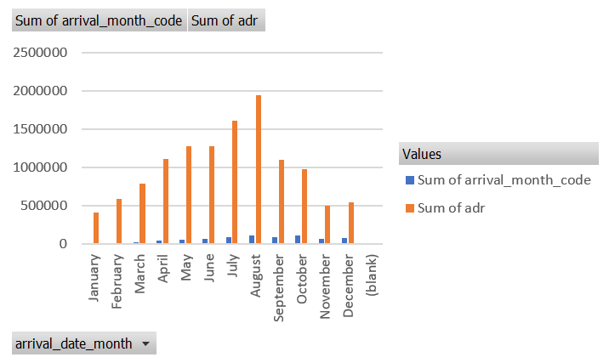
One-way ANOVA model
Conducted ANOVA to assess the influence of "arrival_month" on "ADR" (Average Daily Rate) during the period
2015-2017

Slide 6
Observations
The p-value obtained from ANOVA is practically zero (p < 0.001), indicating extremely strong evidence against the null hypothesis.
Indicates that the differences in ADR between arrival months are highly unlikely to have occurred due to random chance alone.
Test indicates a highly significant F-statistic (F = 422804.499) further strengthens the evidence against the null hypothesis.
Confirms the presence of substantial differences in ADR among the different arrival months.

Slide 7
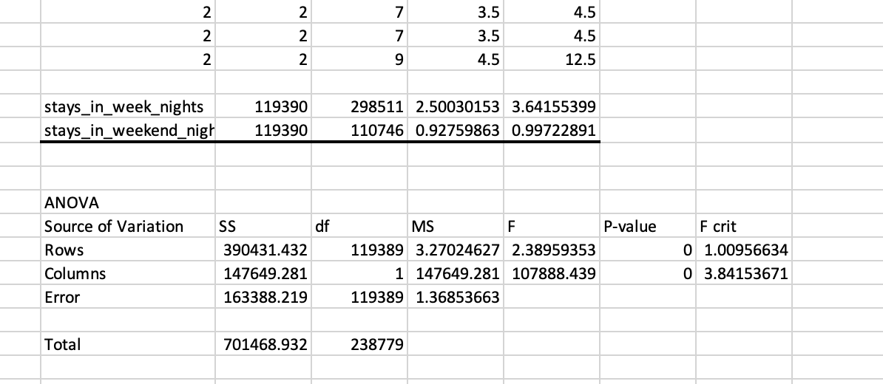
TWO-WAY ANOVA MODEL
Conducted analysis comparing average stays_in_weekend_nights and stays_in_week_nights across different hotel types
(e.g., Resort Hotel, City Hotel) over the period 2015-2017.

Slide 8
Observations
On the dependent variable “Hotel Type”, "stays_in_week_nights" has a statistically significant impact.
'stays_in_weekend_nights' exhibits a noteworthy influence on the dependent variable as well.
Statistical Significance: Strong and statistically significant effects on the dependent variable are indicated by the extremely low p-values (p < 0.05) for both factors.

Slide 9
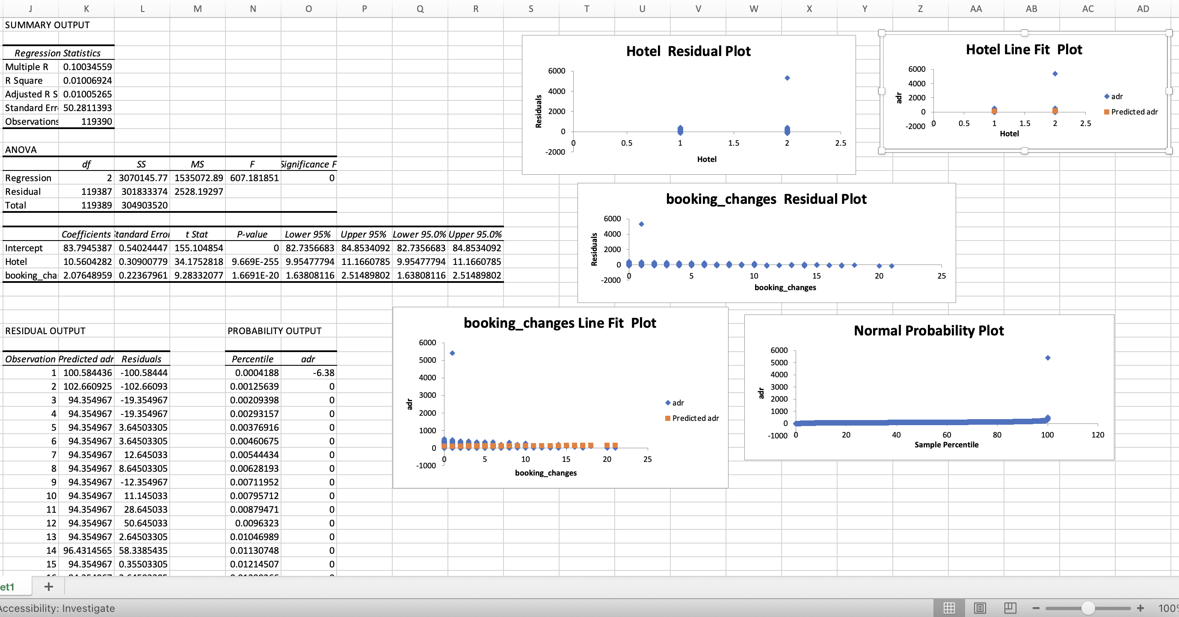
LINEAR REGRESSION MODEL
Constructed a Linear Regression model to describe the relationship between ADR (dependent variable) and
predictor variables (hotel type, booking changes).

Slide 10
Observations
Model Fit and Explanation:
The model explains approximately 1% of the variability in Average Daily Rate (ADR) using predictors such as Hotel type and Booking Changes.
Significant Predictors:
Both Hotel type and Booking Changes exhibit strong statistical significance (p < 0.001) concerning ADR, indicating their impact on ADR values.
Impact of Predictors:
A unit change in Hotel type corresponds to an average ADR increase of around 10.56, while each unit increase in Booking Changes is associated with an average ADR increase of approximately 2.08.
Residual Analysis:
Extreme negative residuals (-100.58 and -102.66) imply potential outliers where the model's predictions significantly deviate from observed ADR values, suggesting areas for further investigation.

Slide 11
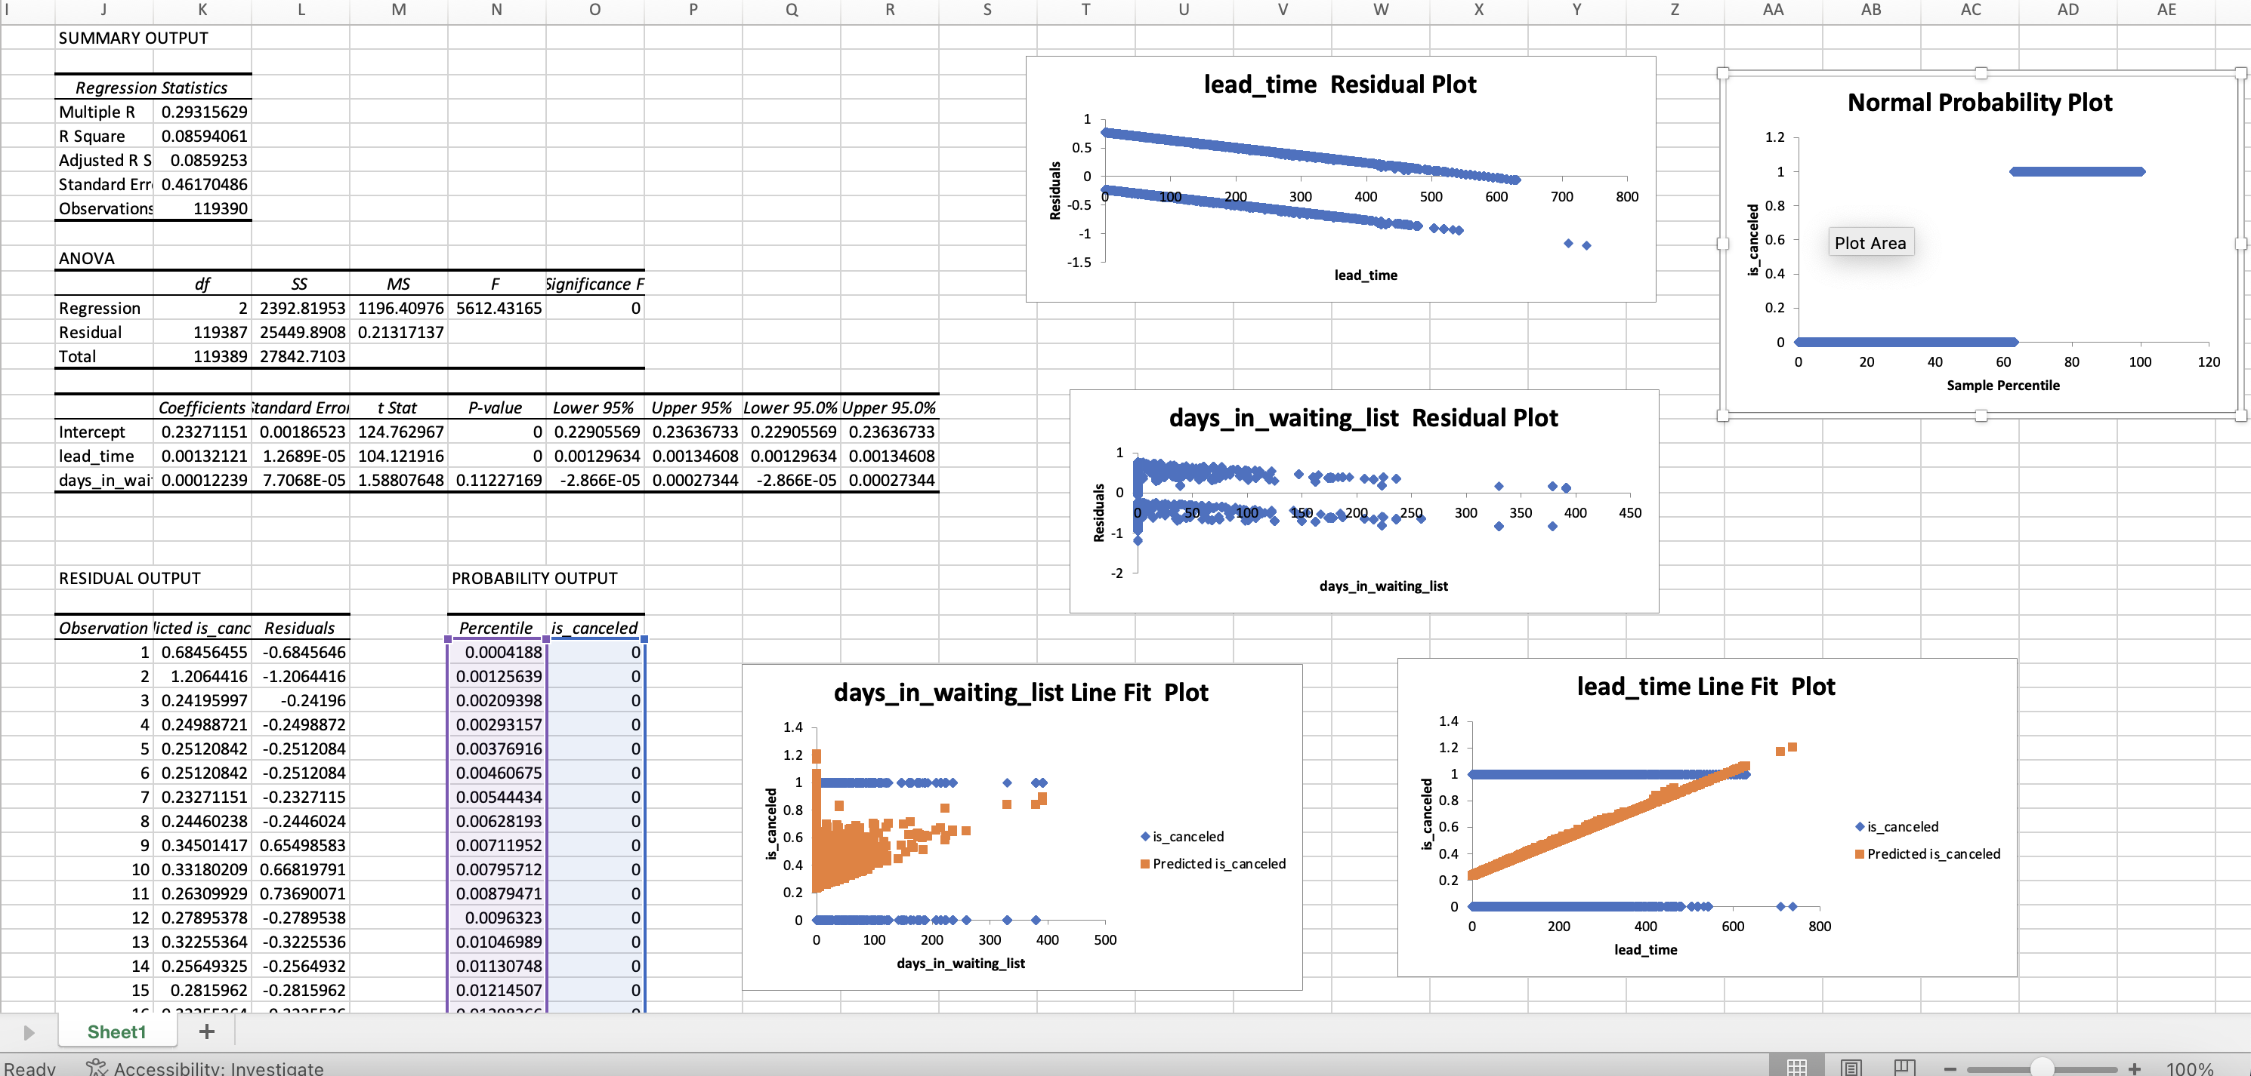
LOGESTIC REGRESSION MODEL
Logistic Regression model to predict hotel reservation cancellations (binary outcome) based on predictors
—lead time and days on the waiting list.

Slide 12
Observations
Model Fit and Explanation:
The regression model explains approximately 8.59% of the variability in predicting "is_canceled" using predictors lead_time and days_in_waiting_list.
Significant Predictors:
Lead_time demonstrates a highly significant relationship (p < 0.001) with "is_canceled," indicating its considerable impact on predicting cancellation probability. However, days_in_waiting_list does not show a statistically significant relationship (p = 0.112), suggesting a weaker impact on predicting cancellations compared to lead_time.
Predictors' Impact:
For each unit increase in lead_time, there is an associated increase in the likelihood of cancellation by approximately 0.00132. Days_in_waiting_list, with a p-value above the significance threshold, might have minimal impact in predicting cancellation probabilities.
Residual Analysis:
The residuals indicate discrepancies between predicted and observed "is_canceled" values, highlighting potential model limitations in accurately predicting cancellations.

Slide 13
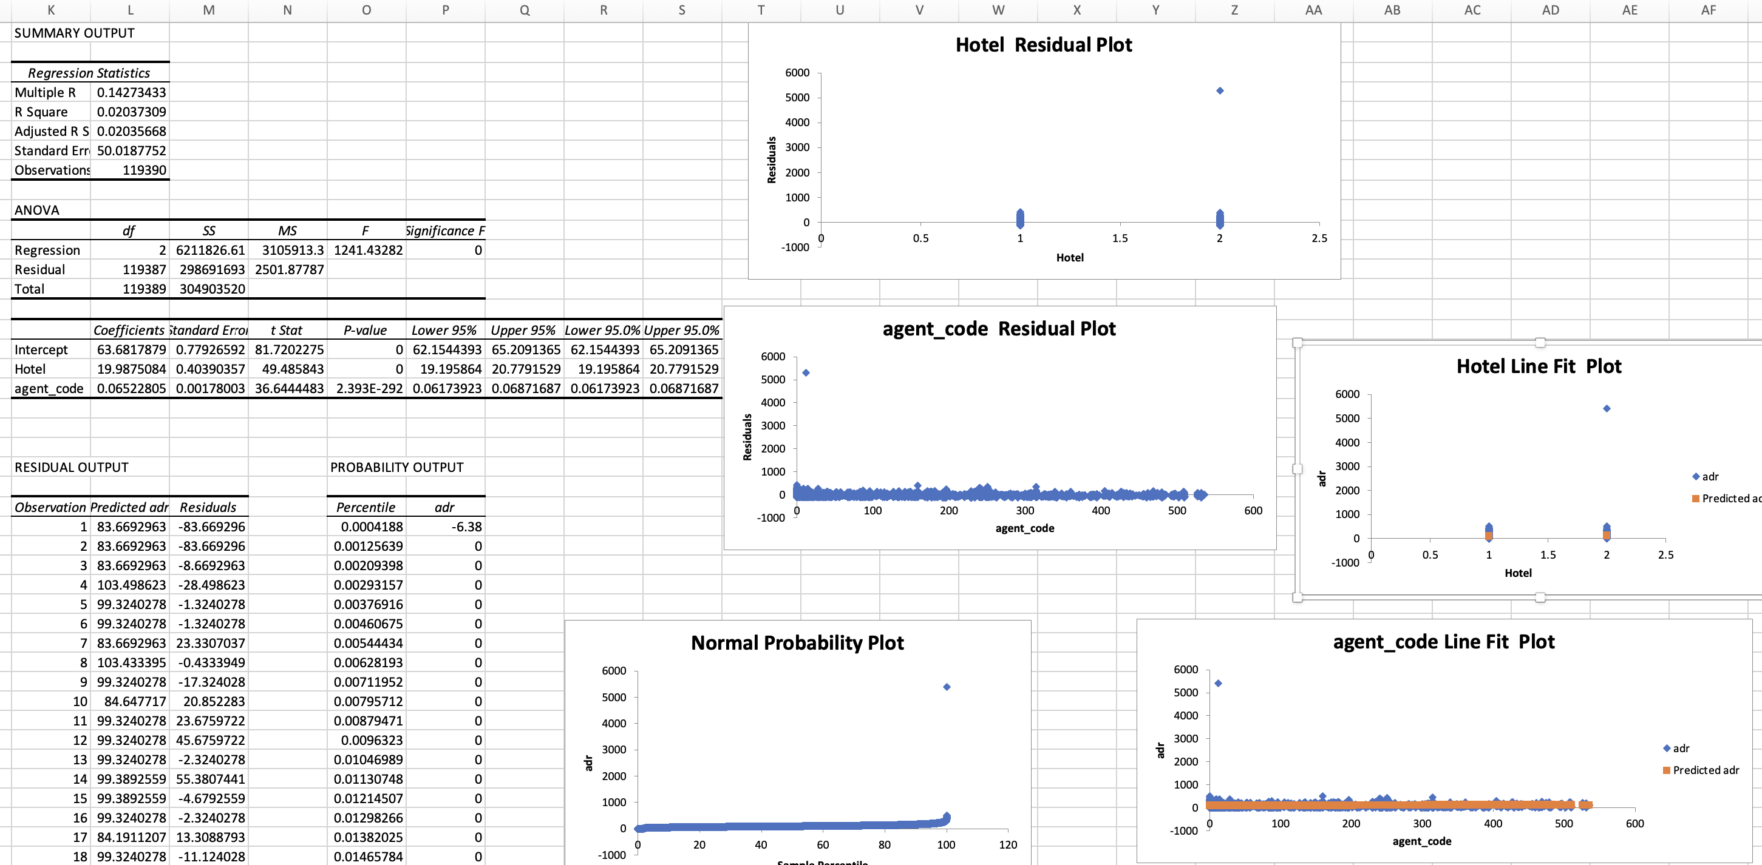
POLYNOMIAL REGRESSION MODEL
Utilized Polynomial Regression to capture potential nonlinear relationships between the choice of agent and ADR.

Slide 14
Observations
Model Fit and Explanation:
The regression model explains around 2% of the variability in Average Daily Rate (ADR) using predictors like Hotel type and Agent code.
Significant Predictors:
Both Hotel type and Agent code demonstrate strong statistical significance (p < 0.001) concerning ADR, indicating their considerable impact on ADR values.
Predictors' Impact:
A unit change in Hotel type is associated with an average ADR increase of approximately 19.99, while each incremental unit in Agent code corresponds to an average ADR increase of around 0.065.
Residual Analysis:
The presence of extreme negative residuals (-83.67) suggests potential outliers where the model's predictions significantly deviate from observed ADR values, warranting further investigation.

Slide 15
Conclusion
The analysis revealed significant relationships between various predictors and the target variables, shedding light on critical factors impacting outcomes.
While certain predictors demonstrated strong significance, others displayed weaker associations, signifying varied impacts on the studied outcomes.
Identified potential outliers in some instances, indicating areas for further investigation or model refinement to enhance predictive accuracy.
The findings provide valuable insights but highlight the need for continuous refinement and exploration to improve the predictive models' precision.

Slide 16
THANK YOU

